Slide 1
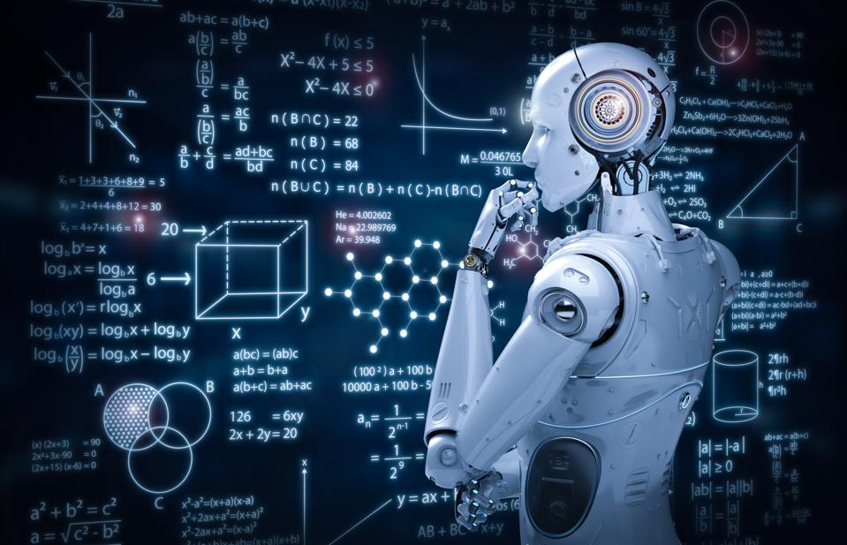
AGILE SW ENGINNERING AND DEVOPS
Name –Chandraleksha.r
BSC(HONS) 2ND SEM

Slide 2
ARTIFICAL INTELLIGENCE
The Human Intelligence inside the computer is called as Artificial Intelligence
The Branches of Artificial Intelligence are:
Machine Learning
Deep Learning
Natural Language Processing
Robotics
Expert Systems
Fuzzy Logic

Slide 3
MACHINE LEARNING
Machine Learning is a field of artificial Intelligence
Making the Machines to learn
There are Three types of Machine Learning:
Supervised Learning
Unsupervised Learning
Reinforcement Learning

Slide 4
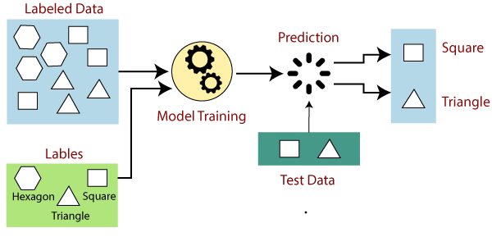
SUPERVISED LEARNING
Machine learning is supervised learning. It involves learning from somebody or someone.
When an input is supplied as a labelled dataset, a model can learn from it. This learning process is known as supervised learning.

Slide 5
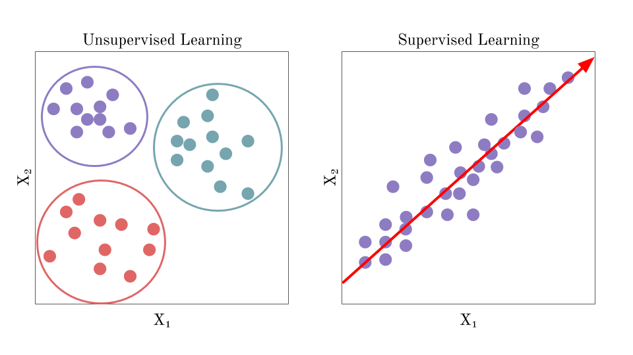
UNSUPERVISED LEARNING
Unsupervised Learning is a machine learning. It is learning on own
It is a type of learning that helps to find previously unknown patters in dataset without pre existing labels.

Slide 6
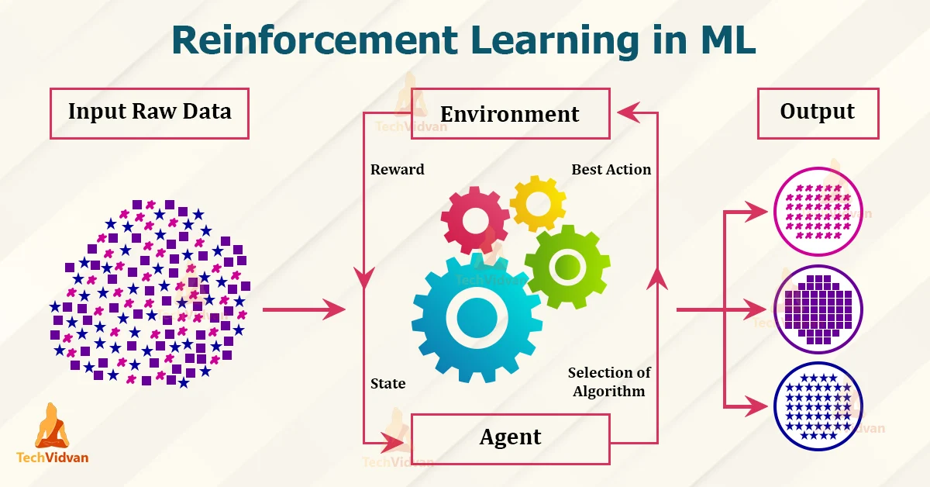
REINFORCEMENT LEARNING
It involves Rewards and penalties

Slide 7
MACHINE LEARNING ALGORITHM
The components of Machine Learning Algorithm are
Features - Input (y=2x)
Labels - Output
Model - Program/Function
Example- : If input is given as x= (1,2,3,4,5) and output as y=(2,4,6,8,10) the mathematical model formed would be y=2x

Slide 8
TYPES OF ML ALGORITHMS
Linear Regression
Non-Linear Regression
Logistic Regression
Decision Tree
Random Forest
KNN(K Nearest Neighbors)
SVM(Support Vector Machine)
Naïve Bayes Algorithm

Slide 9
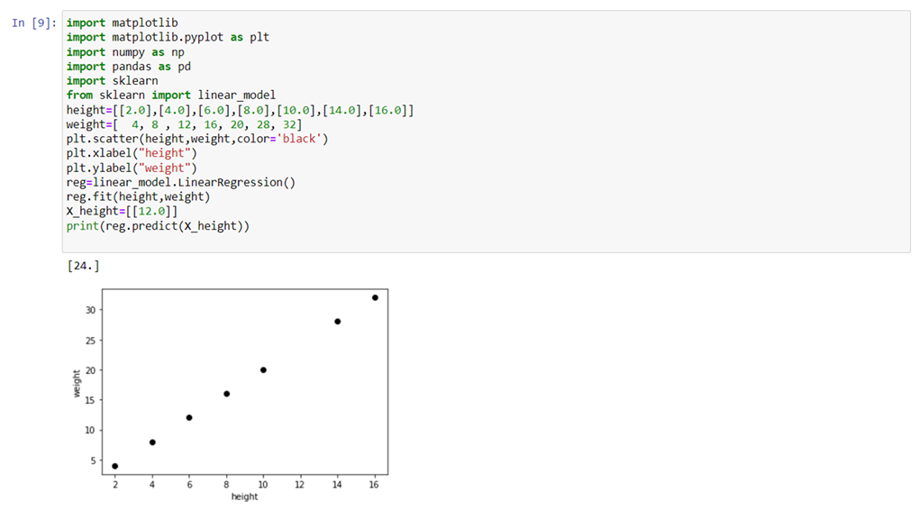
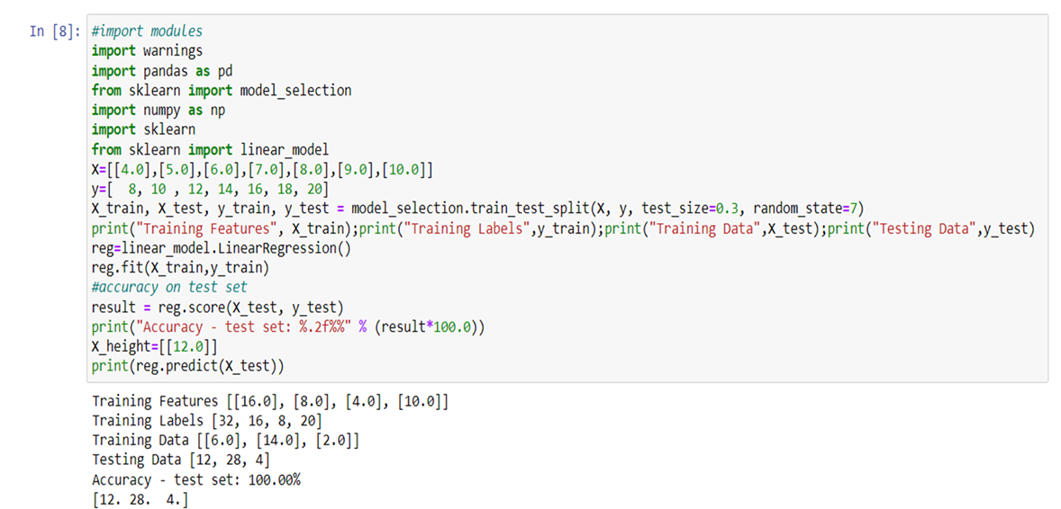
LINEAR REGRESSION And Algorithm
Algorithms used in machine learning include linear regression.
It is used in statistical techniques for analysis that is predictive.

Slide 10
NON LINEAR REGRESSION
Nonlinear regression is a feature of computer algorithms.This is utilised to both find the difficult and gives correct results.
Based on the input dataset, the analysis creates a curve that shows the relationship between the variables.

Slide 11
LOGISTIC REGRESSION
Logistic regression is used to estimate the probability that a binary (yes/no) event will take place.
Similar to how linear regression is used to tackle regression issues and logistic regression is used to treat classification issues

Slide 12
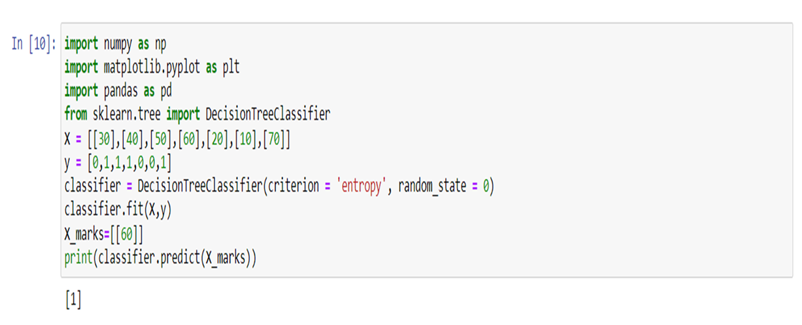
DECISION TREE and Algorithm
Guided learning includes decision trees.
Decision Tree is a graphical representation that can be used to address both regression and classification problems.

Slide 13
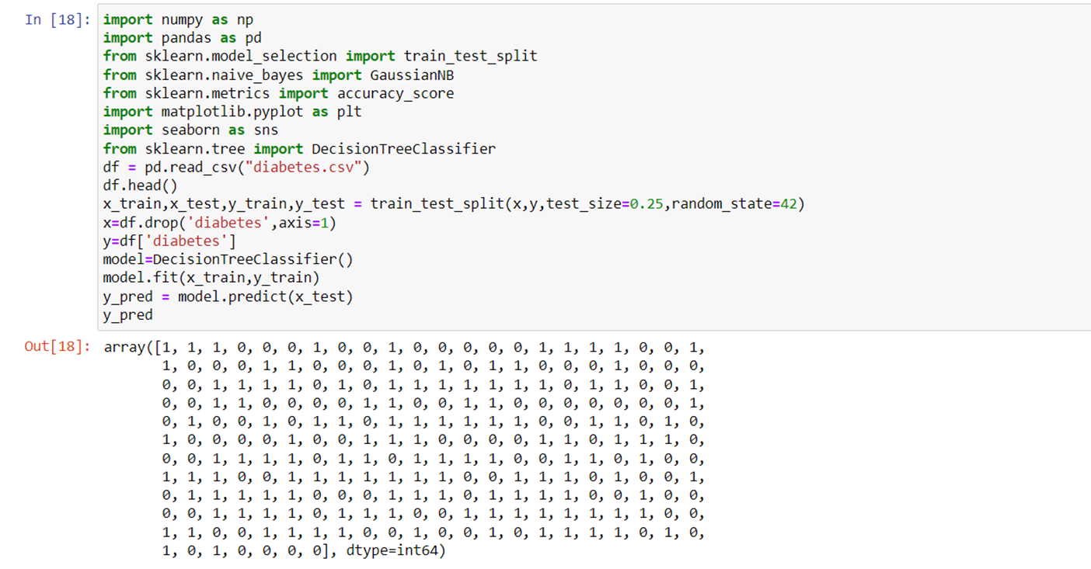
DECISION TREE- DIABETES DETECTION

Slide 14
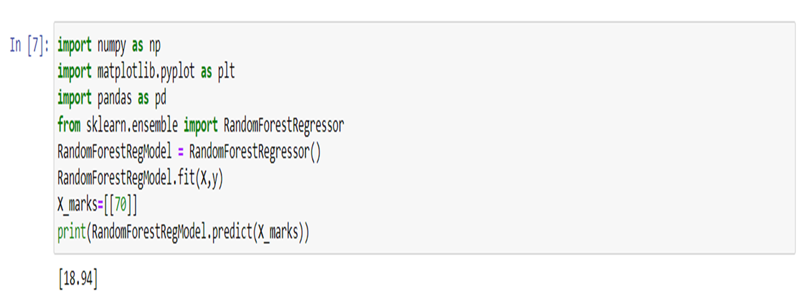
RANDOM FOREST and Algorithm
Random Forest is used to solve classification and regression issues. It is used to create trees for various data, and it uses the majority vote for classification and the average in regression cases.

Slide 15
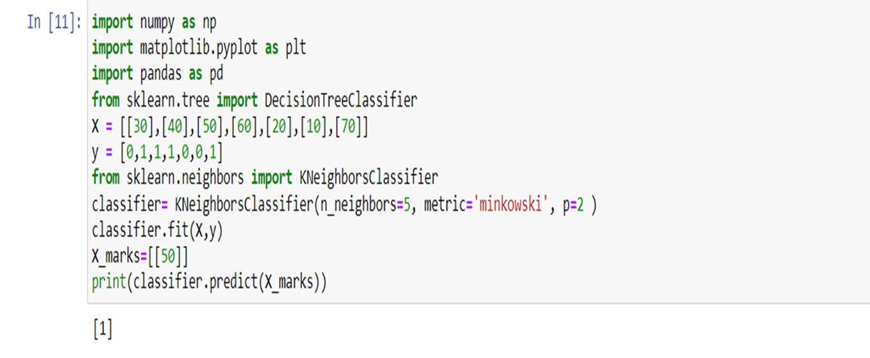
KNN(K NEAREST NEIGHBOURS
K Nearest Neighbors comes under supervised Learning
It stores all the available data and classifies a new data based on the similarity.

Slide 16
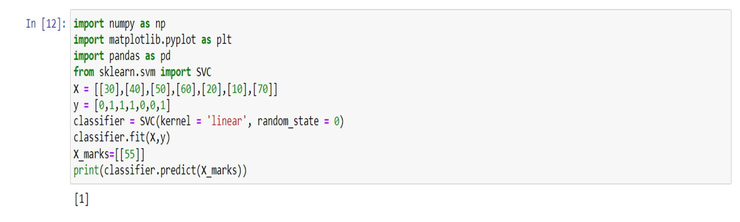
SVM( SUPPORT VECTOR MACHINE)
SVM is used in supervised learning, it is used for classification and regression problem.

Slide 17
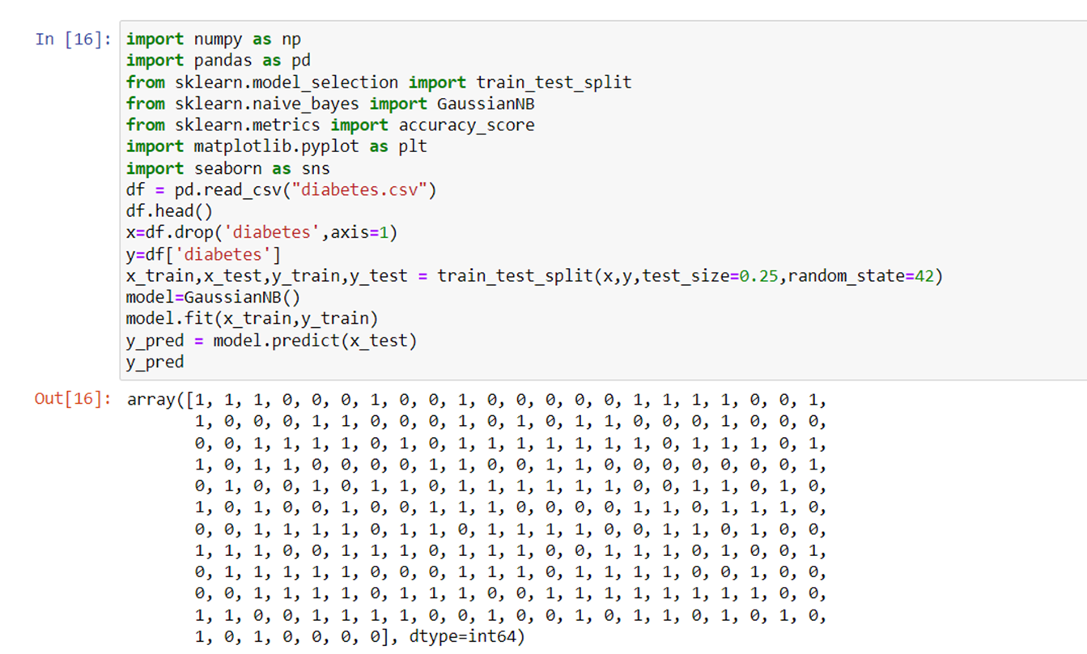
NAÏVE BAYES ALGORITHM

